Slide 1



Performance testing meets
The Cloud

Slide 2

What is Performance Testing?

Slide 3
Wiki:
a testing practice performed to determine how a system performs
in terms of responsiveness and stability
under a particular workload
https://en.wikipedia.org/wiki/Software_performance_testing

Slide 4
Server
(system under load)
User 1
User 3
…
User n
User 2

Slide 5
Performance testing: best practices
Users are different - i.e. sending unique (not hardcoded) requests
Users are geographically distributed – so should be the test
Performance testing should be done regularly

Slide 6
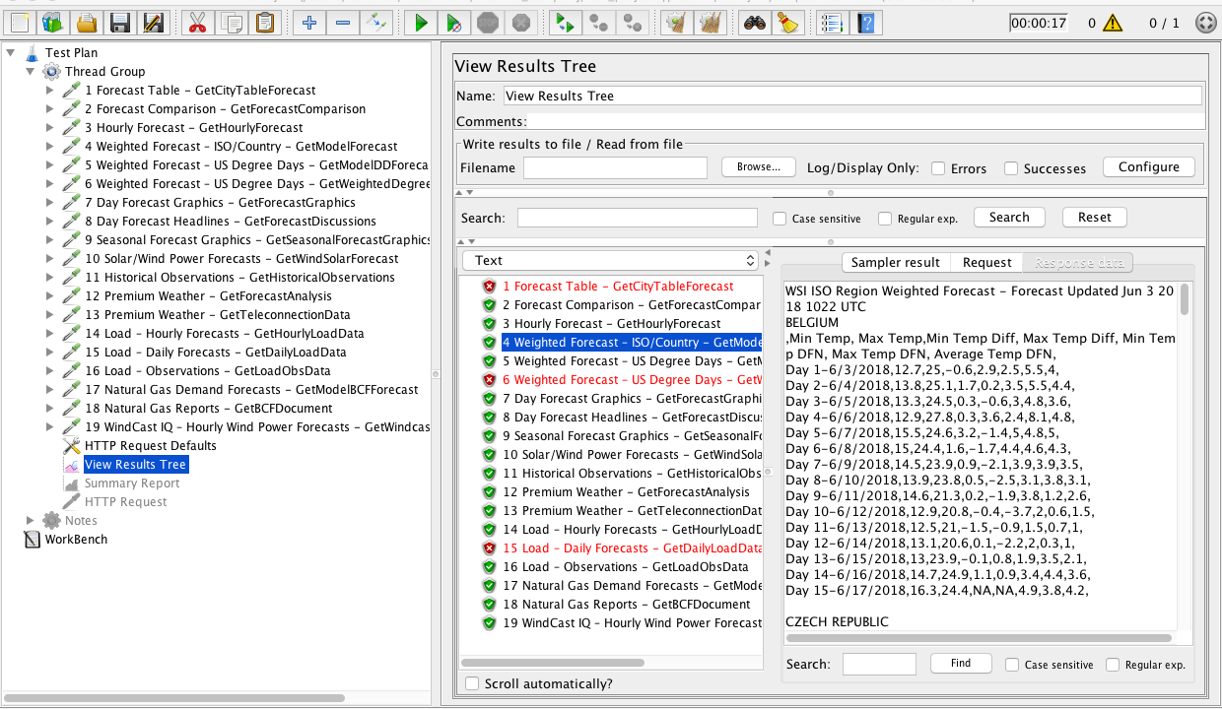
1. Emulate real users - JMeter

Slide 7
JMeter Pros:
Easy to start
Scripts to generate unique requests on the go (Groovy, BeanShell, etc.)
Collects performance metrics and generates pretty reports
Active community and plenty of extensions for non-trivial tasks
Allows distributed testing - important

Slide 8
However:
No geographical diversity – all requests coming from the same region (throughput limitation)
Limited abilities of a single instance to generate load (memory issues)
Thus:
running tests with a single JMeter instance is not a proper performance testing

Slide 9
Solution:
Set up several JMeter instances in different areas (Amazon Web Services might help)
Run performance tests in distributed mode

Slide 10
Server (system under load)
Requests
Responses
…
JMeter
Slave 1
JMeter
Slave 2
JMeter
Slave n
Performance Stats
RMI Instructions
JMeter Master
Load Scenario
Performance Report

Slide 11
Setting up an AWS EC2 instance with JMeter:
Set up Virtual Private Cloud;
Set up Subnet;
Set up Internet Gateway;
Set up Route Table and Association;
Set up Security Group;
Add Key Pair;
Start Instance with public IP;
Install and configure JMeter (open ports, get IP).
Do that as many times as many instances you want.

Slide 12
Run distributed JMeter test in console:
jmeter -n -t load_script_name.jmx
-R 54.172.38.36,…,18.144.50.21 -l report_name.jtl

Slide 13
Dockerize JMeter:
Ubuntu + Java
Ubuntu + Java
JMeter Master
(Manages Slaves):
- Port 60000 open
JMeter Slave
(Generates Load):
- Port 1099 open
- Port 50000 open

Slide 14
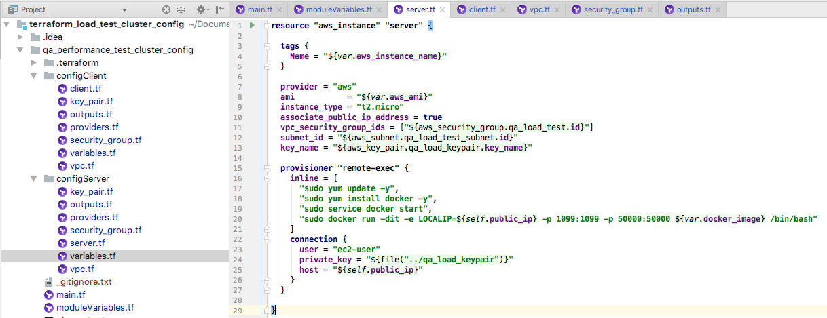
Take automation one step further?
Configure the AWS infrastructure automatically with Terraform:

Slide 15
Before you run the whole thing,
make sure to have:
Valid AWS credentials in ~/.aws/credentials file
Terraform tool installed (v0.11.2)

Slide 16
In the command line,
clone the project:
git clone https://github.com/artie-sh/performance_testing_terraform_aws_docker_jmeter.git
enter the project folder:
cd performance_testing_terraform_aws_docker_jmeter

Slide 17
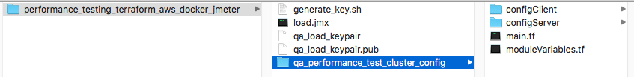
generate ssh keys:
./generate_key.sh

Slide 18
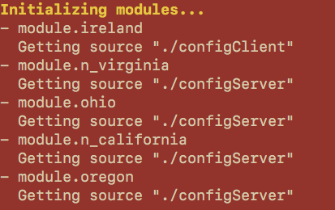
enter the terraform folder:
cd qa_performance_test_cluster_config
initialize modules:
terraform init

Slide 19
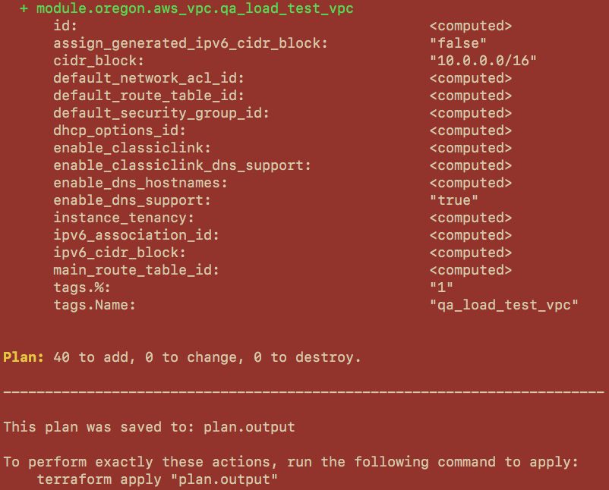
plan the output:
terraform plan -out plan.output

Slide 20
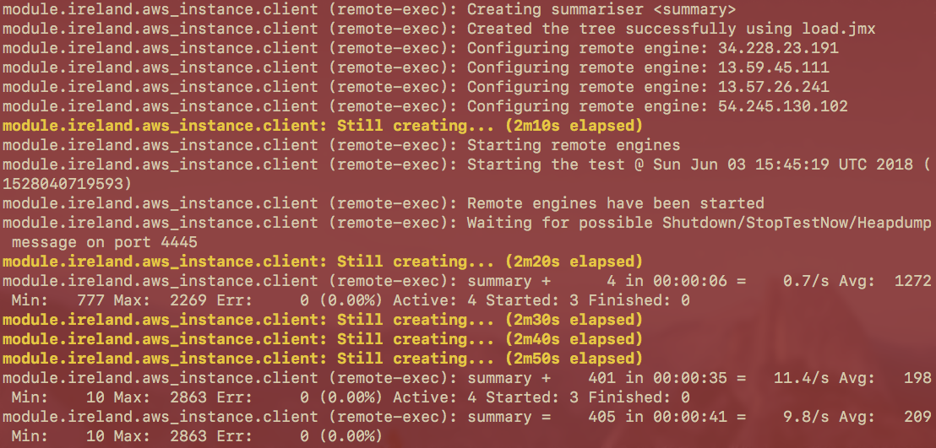
apply the plan:
terraform apply plan.output

Slide 21
agree to accept the report file:
yes + enter

Slide 22
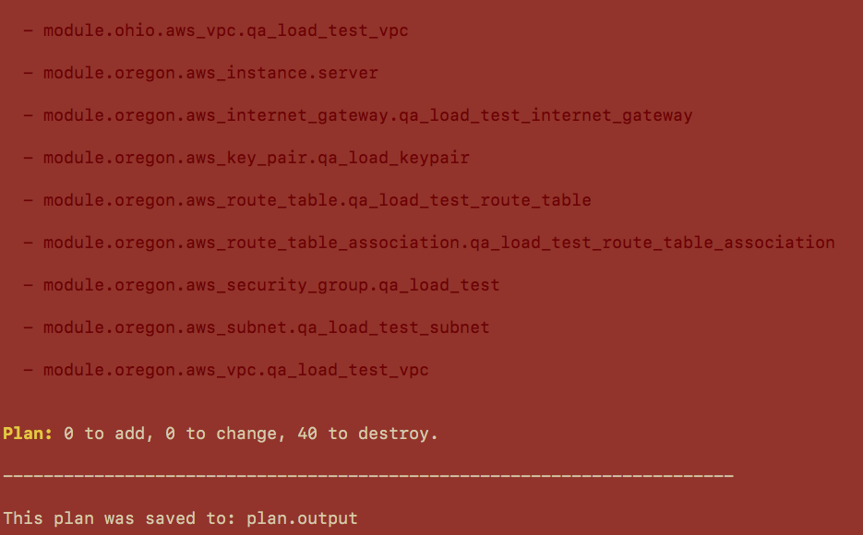
destroy infrastructure after test is done:
terraform plan -destroy -out plan.output

Slide 23
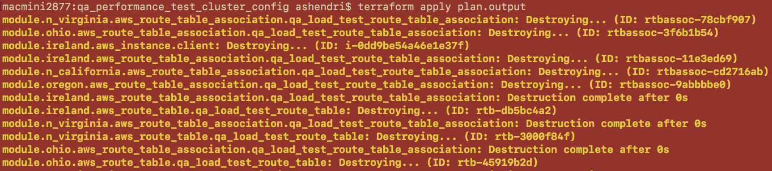
apply destroy plan:
terraform apply plan.output

Slide 24
Header
content

Slide 25
See you on our next meeting in July!
05 / 07 / 2018

